Slide 1


Name Assem Ihab Task: Hotel Reservation Analysis with SQL
Notes:
"Hi, my name is Assem Ihab.
The essence of this task is to analyze a hotel reservation table using SQL and gain insights."

Slide 2
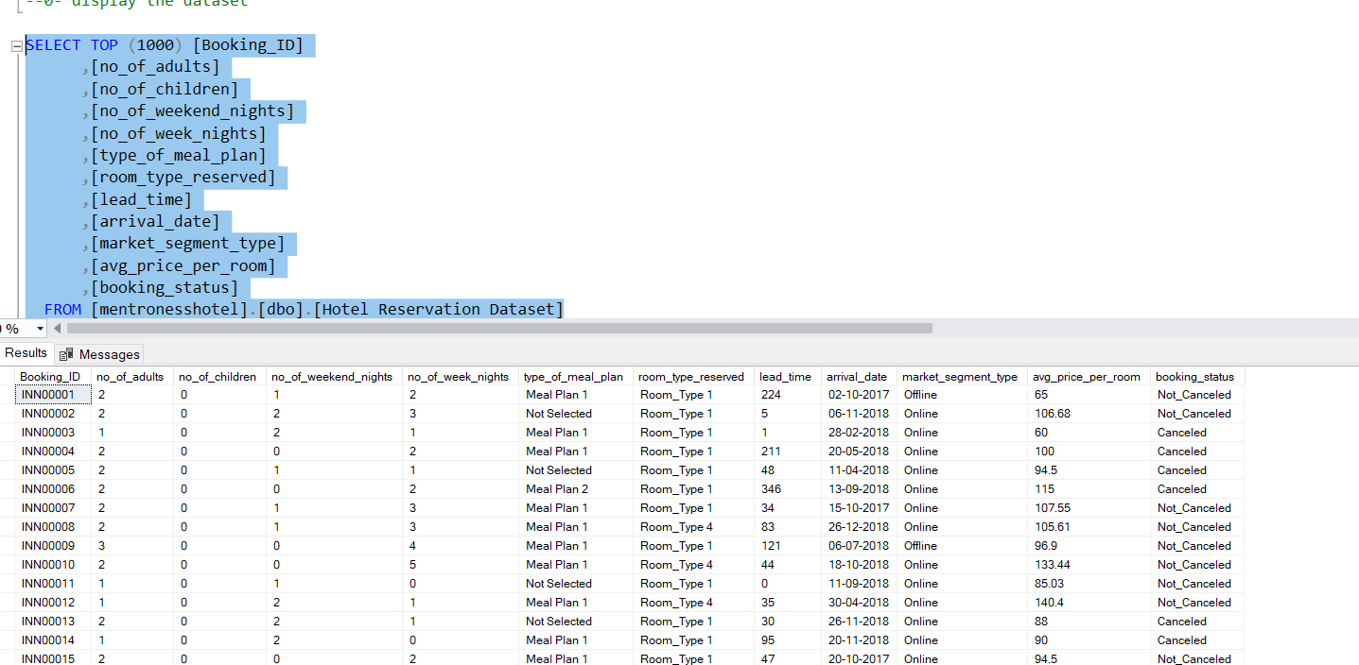
Data snapshot
Notes:
Here is a snapshot of the data. Our columns range from reservation ID and reservation status to room type, etcetera."

Slide 3
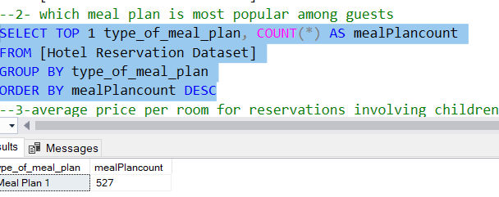
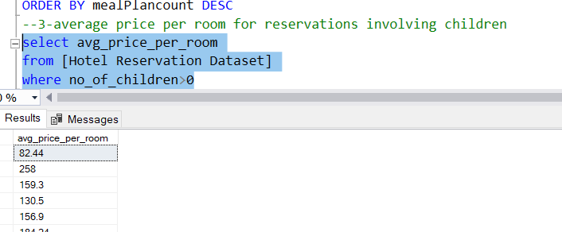
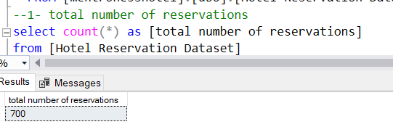

Slide 4
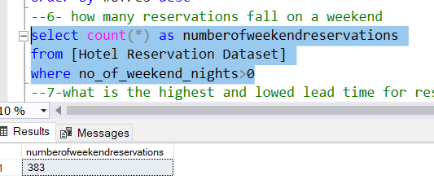
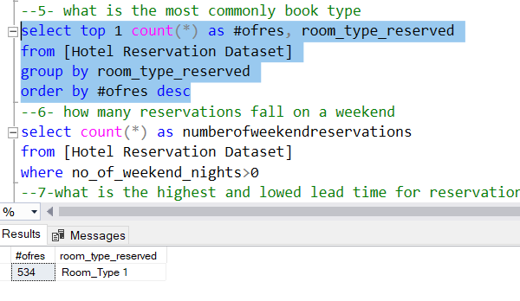
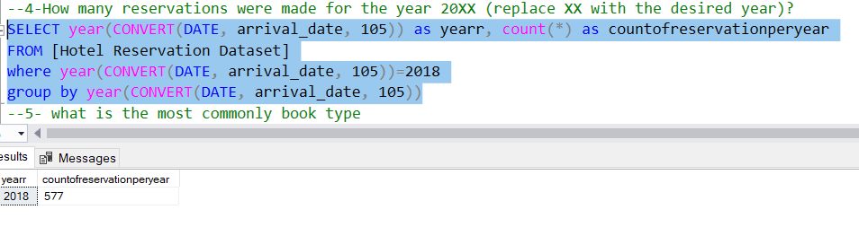

Slide 5
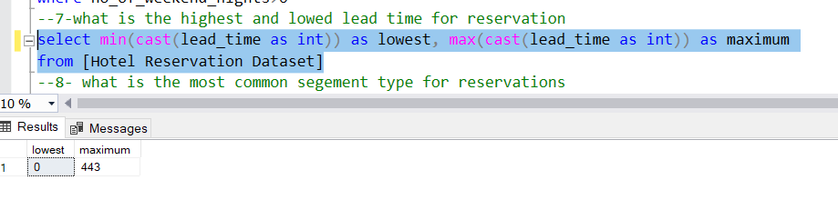
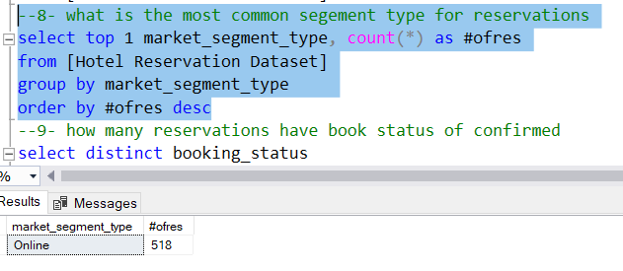

Slide 6
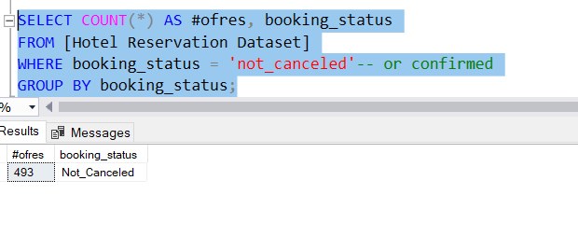
"Problem 9 has no option called 'confirmed,' but there is 'not cancelled.'"

Slide 7
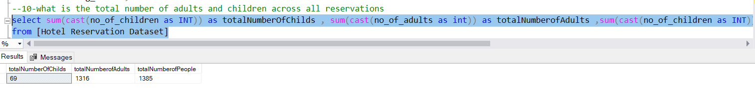
Notes:
Problem 10 has two answers: the total number of children and the total number of adults alone. The third one is the total number of people

Slide 8
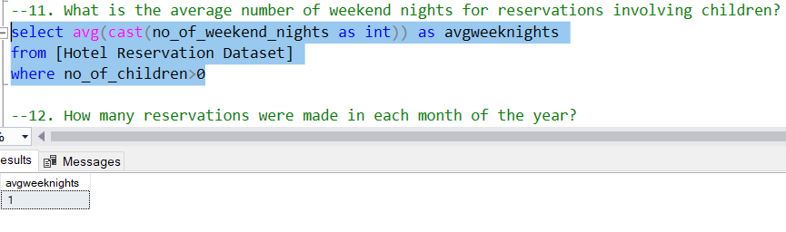

Slide 9
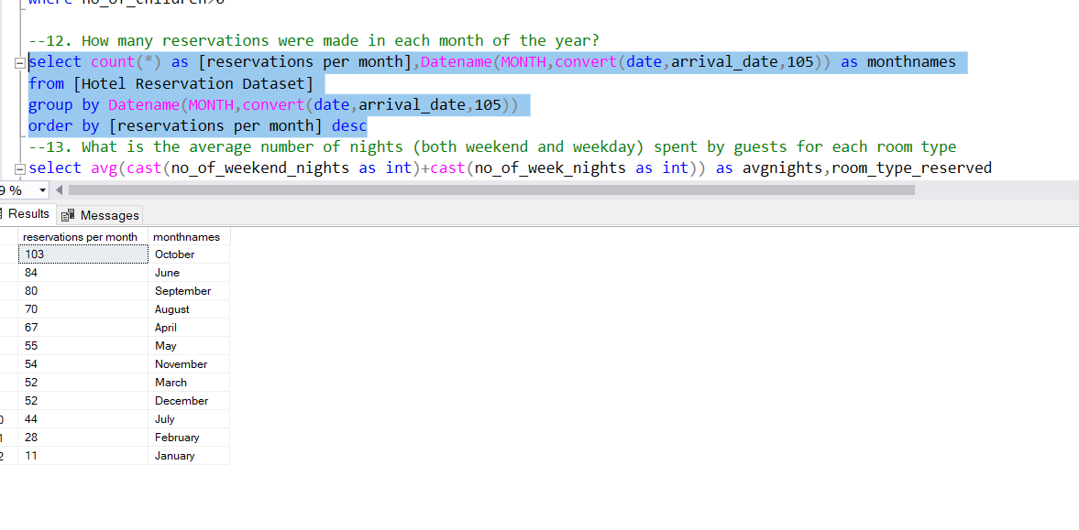

Slide 10
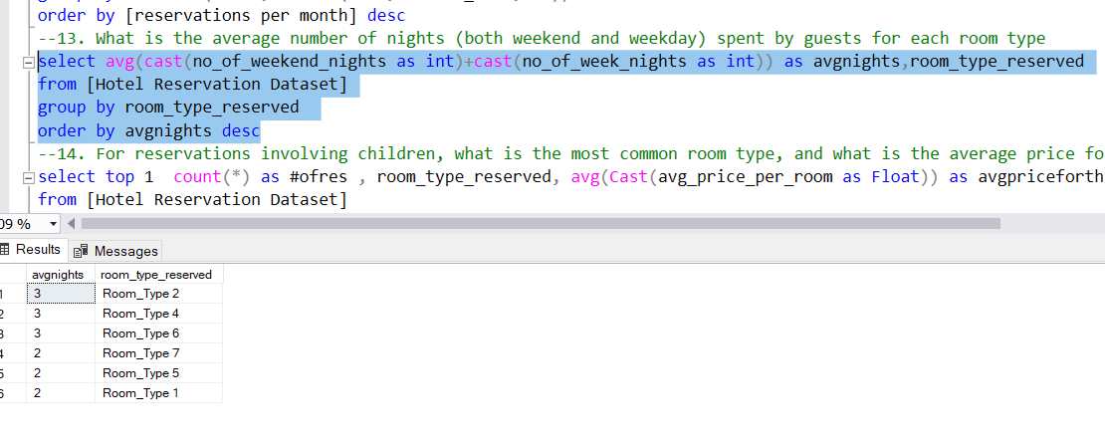

Slide 11
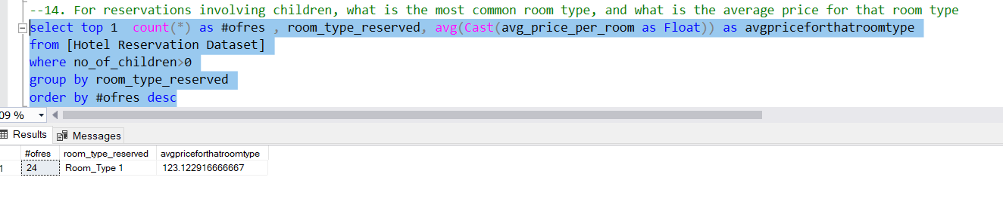
Notes:
Room type 1 is the most common room type for reservations that involve children and it’s average price is 123

Slide 12
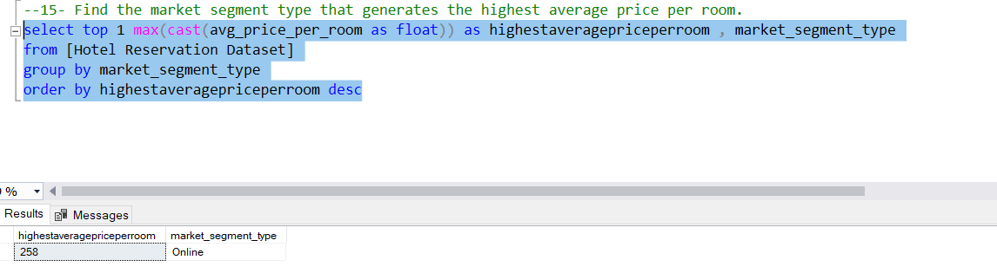
Notes:
The market segment type that have the highest average price per room is the online segment type

